Slide 1
Preprocessing Part 1
OPIM 5604 – Predictive Modeling
Jennifer Eigo

Slide 2
Module Topics
SEMMA framework
Identify variable data types
Visualize data
Find missing values
Find outliers

Slide 3
Core Ideas in Data Mining
Data Mining
Supervised Learning (Predictive Analytics)
Unsupervised Learning
(Descriptive Analytics)
Association Rules
Data Exploration &
Visualization
Prediction
Time Series
Classification
Data Reduction &
Dimension Reduction

Slide 4
Supervised Learning
Goal: Predict a single “target” or “outcome” variable
Training data, where target value is known
Score data where value is not known
Methods: Classification and Prediction

Slide 5
Predictive Modeling Example
Who will cheat on their taxes?
Use what we know to predict what we don’t.
categorical
categorical
continuous
target class
TID | Refund | Marital Status | Taxable Income | Cheat on Taxes
1 | Yes | Single | 125K | No
2 | No | Married | 100K | No
3 | No | Single | 70K | No
4 | Yes | Married | 120K | No
5 | No | Divorced | 95K | Yes
6 | No | Married | 60K | No
7 | Yes | Divorced | 220K | No
8 | No | Single | 85K | Yes
9 | No | Married | 75K | No
10 | No | Single | 90K | Yes
Refund | Marital Status | Taxable Income | Cheat on Taxes
No | Single | 75K | ?
Yes | Married | 50K | ?
No | Married | 150K | ?
Yes | Divorced | 90K | ?
No | Single | 40K | ?
No | Married | 80K | ?

Slide 6
Unsupervised Learning
Goal: Segment data into meaningful segments; detect patterns
There is no target (outcome) variable to predict or classify
Methods: Association rules, data reduction & exploration, visualization

Slide 7
The SEMMA Process

Slide 8
SEMMA Approach to Data Mining
Business Imperative +
Sample
You gather the data by creating one or more tables. The sample should be large enough to contain the significant information, but small enough to process.
Explore
You search for anticipated relationships, unanticipated trends, and anomalies to gain understanding and ideas. Use statistical methods and visualizations.
Modify
You change the data by creating, selecting, and transforming the variables to focus the model selection process. Fix errors to clean the data. Create better predictors through feature engineering.
Model
You model the data by using the analytical tools to search for a combination of the data that reliably predicts a desired outcome.
Assess
You evaluate competing predictive models by building charts to evaluate the usefulness and reliability of the findings from the data mining process.

Slide 9
Data Mining Effort
100
90
80
70
60
50
40
30
20
10
0
Business
Objective
Determination
Data
Preparation
Data
Modeling
Analysis of
Results and
Knowledge
Assimilation

Slide 10
Not a one-time initiative
Models need to be maintained over time
Adapt to changes in the business environment
Leverage new data as it becomes available

Slide 11
Preprocessing Data

Slide 12
Types of Variables
Main distinction: Categorical vs. numeric
Numeric
Continuous
Example – number of miles a car has been driven
Integer
Example – number of doors a car has
Categorical
Ordered
Example – car trim level
Unordered
Example – car color

Slide 13
Types of Variables
Note: Not all numbers are treated as numeric!
Month is often shown as 1 to 12 but is categorical
Yes, February is one more than January…
But only if they are in the same year
February 2024 is 11 fewer months compared to January 2025
Binary indicators are often shown as 0 and 1 but are categorical
1 = Yes; 0 = No
Different data types require different modeling or statistical techniques

Slide 14
Graphs for Data Exploration
Basic Charts
Line Graphs
Bar Charts
Scatterplots
Distribution Plots
Histograms
Boxplots
We use visualizations to better understand the structure and patterns in the data.
The more we understand the data, the better the models we can build.

Slide 15
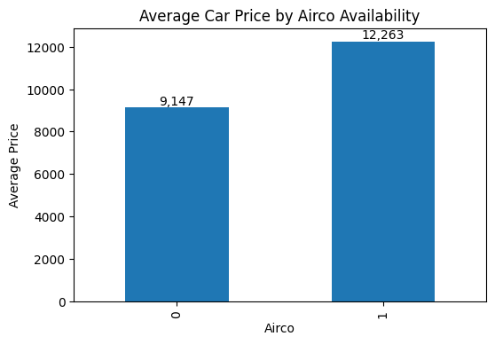
Bar Chart for Categorical Variable
Y-axis is average price for Toyota Corollas shown separately for those with air conditioning (1) versus those without (0).

Slide 16
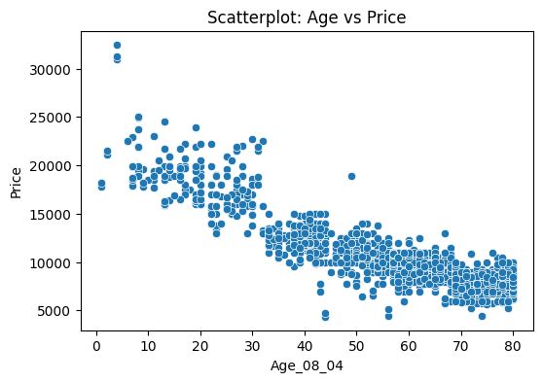
Scatterplot
Displays the relationship between two numerical variables such as price and vehicle age

Slide 17
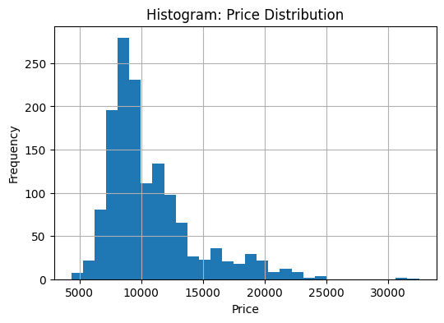
Histograms
Histogram shows the distribution of the outcome variable (Price) or any other variable

Slide 18
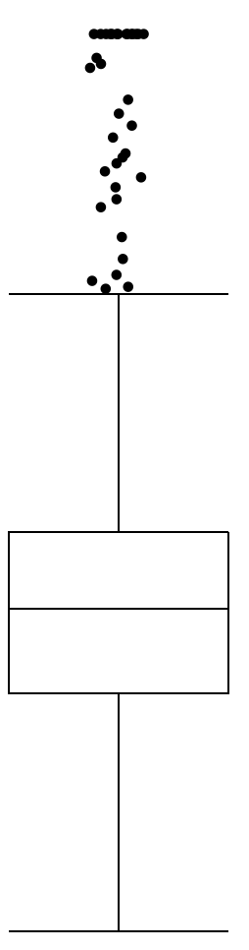
Outlier Box Plot
Top outliers defined as those above Q3+1.5(Q3-Q1).
“max” = maximum of non-outliers
Analogous definitions for bottom outliers and for “min”
outliers
“max”
Quartile 3
Median
Quartile 1
“min”

Slide 19
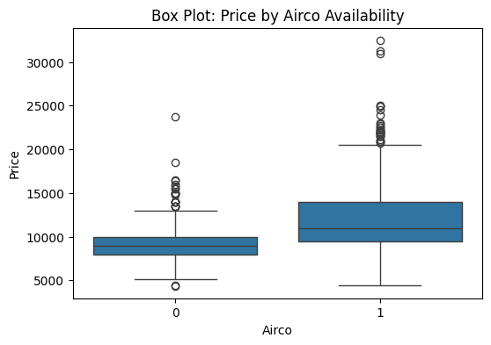
Boxplots
Side-by-side boxplots are useful for comparing subgroups
Distribution of the outcome variable (Price) for cars with air conditioning (1) and without (0)

Slide 20
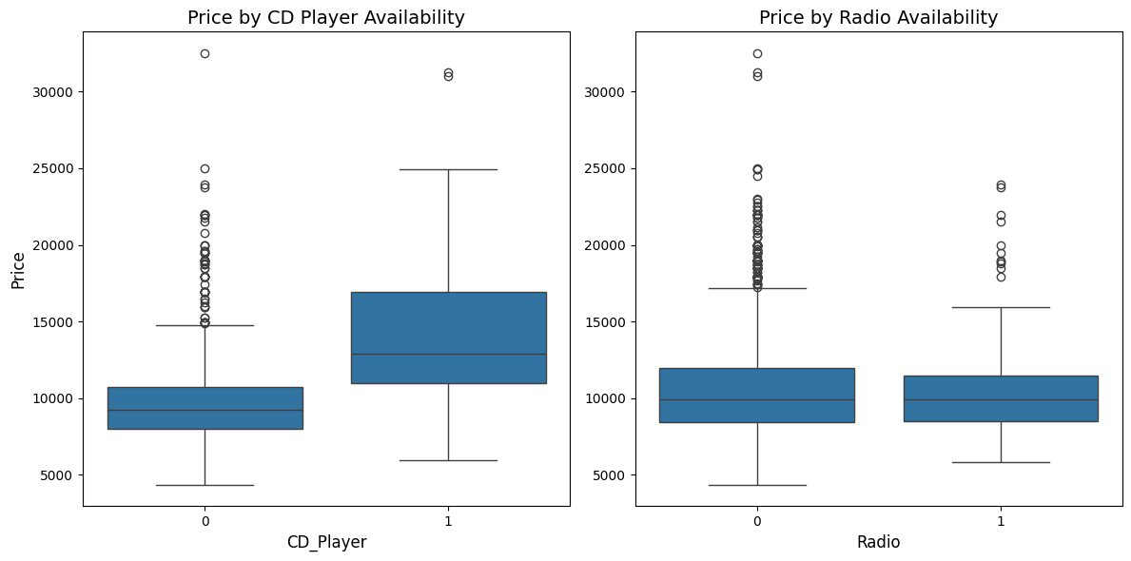
Comparative Box Plots
Comparing distributions for the values Price across several possible categorical predictors
The best predictors show the most different distributions among subgroups

Slide 21
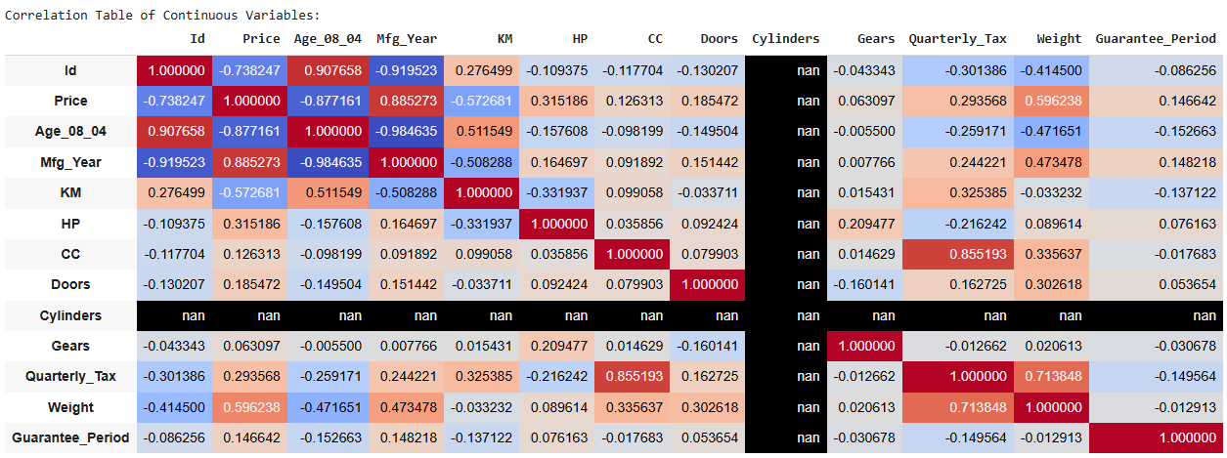
Color Map to Highlight Correlations
Color-coded correlation table shows relationships amongst continuous variables
Close to 1 = strong positive correlation
Close to 0 = no correlation
Close to -1 = strong negative correlation

Slide 22
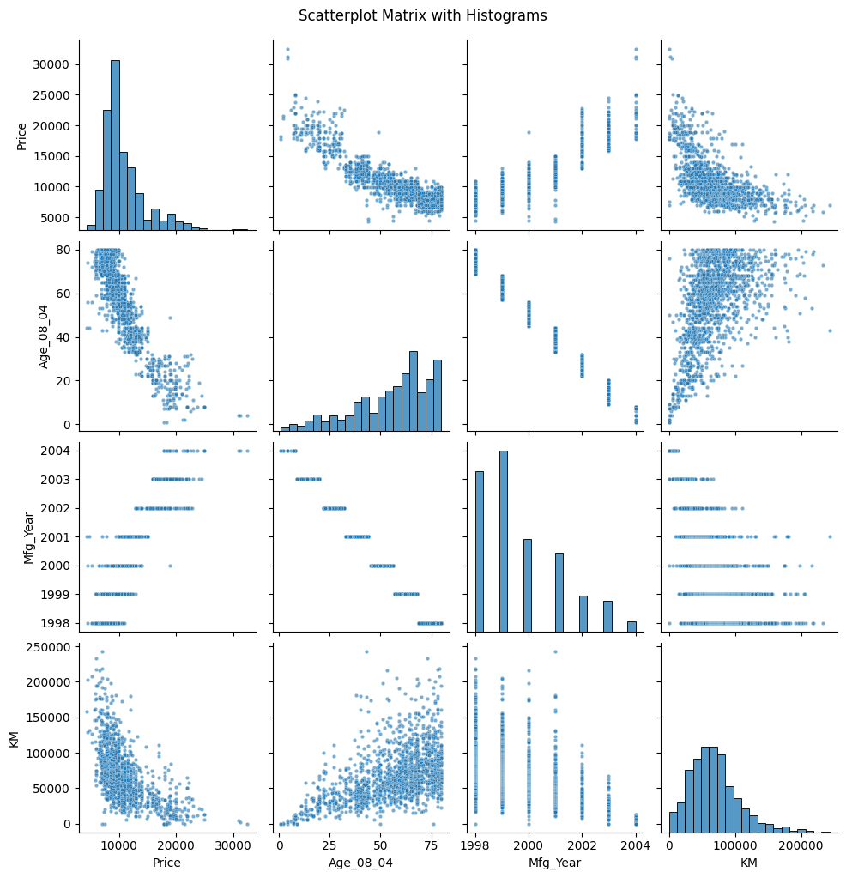
Scatterplot Matrix
Scatterplot matrixes help you visualize the correlation number
In the diagonal cells we see just a basic histogram of each variable included

Slide 23
Detecting Missing Values
Missing values are gaps in the data
Can be an actual null value or other implied values
NA
0000
9999
Others…
Use visualization tools to help find them

Slide 24
Detecting Outliers
An outlier is an observation that is “extreme”, being distant from the rest of the data (definition of “distant” is deliberately vague)
Outliers can have disproportionate influence on models (a problem if it is spurious)
An important step in data pre-processing is detecting outliers
Once detected, domain knowledge is required to determine if it is an error, or truly extreme.

Slide 25
Detecting Outliers
In some contexts, finding outliers is the purpose of the DM exercise (airport security screening)
This is called “anomaly detection”
Notes:
25

Slide 26
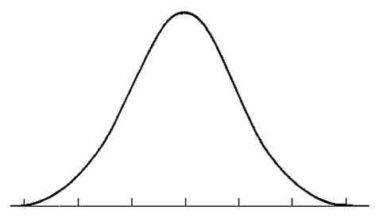
Detecting Outliers – Quantile Range
0.1
0.9
Outliers
Outliers
80%
-400
-300
-200
-100
0
100
200
300
400
500
In this example :
Tail Quantile = 0.1 = 10%
Mid Interval = 1 – 2 x Tail Interval = 0.8 = 80%
Inter Quantile Range = 100
Q = number of intervals to accept before calling something an outlier = 3
Outliers are anything < -300 or > 400
Notes:
26

Slide 27
Detecting Outliers – Quantile Range
Are there any outliers in the CC column?
Tail Quantile = 10% Lower 10% Quantile = 1300 Upper 10% is the 90% Quantile = 1900 Inter Quantile Range = 1900 – 1300 = 600
Q indicates how many multiples of the IQR you tolerate before calling something an outlier
Low Threshold = Low Quantile – (IQR x Q) = 1300 – (600 x 3) = -500
High Threshold = High Quantile + (IQR x Q) = 1900 + (600 x 3) = 3700
Notes:
27

Slide 28
Outliers – Mahalanobis Distance
Row level distance calculation
Takes into account different scales across columns
Takes into account correlations amongst the columns
Tells us how different (or similar) each row is compared to all the other rows in the dataset
Requires matrix math so we let the code do the work!
https://en.wikipedia.org/wiki/Mahalanobis_distance

Slide 29
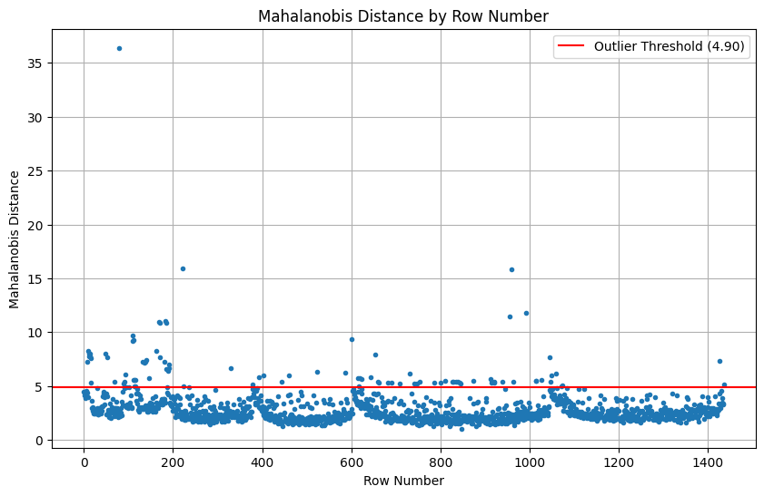
Outliers – Mahalanobis Distance
Several rows fall above the threshold

Slide 30
Summary
Data Mining consists of supervised methods (Classification & Prediction) and unsupervised methods (Association Rules, Data Reduction, Data Exploration & Visualization)
Most common data types – continuous and categorical
Data visualizations help us understand the data
Missing values need to be identified
Outliers are extreme values that can skew results

